Slide 1
🎬 A REENTRANCY STORY
🏦
The Vault That Paid Twice
How a 1-ETH thief walks out with 11 ETH — without forcing a single lock. 💰
👥 GROUP 6 M.Tech AI · IIT Jodhpur · Trimester 2
CSL6010 Cyber Security · Assignment 1 · Prof. Susil Kumar Mohanty · TA: Nidhi Srivastava

Slide 2







👥 TEAM · GROUP 6
👥 Meet the Team
Rohit Patel
Sharvan Vittala
Sudeb Ghosh
Kosuru Yuvaraj
G25AIT2089
G25AIT2099
G25AIT2113
G25AIT2054
Pujan Chakraborty
Amit Singh
Vishnu Priya
G25AIT2076
G25AIT2007
G25AIT2128
🔓 Reentrancy Attack · Group 6 · CSL6010 Cyber Security · IIT Jodhpur

Slide 3
🗺️ ROADMAP · THE STORY IN 6 ACTS
🗺️ The Story in 6 Acts
🏦
⏳
ACT 1 · The Setup
ACT 2 · The Gap
a bank teller, two simple steps
the fatal pause between cash & pen
🚨
🔍
ACT 3 · The Heist
ACT 4 · The Evidence
re-enter, loop, and drain the vault
the code, line by line
💥
🛡️
ACT 5 · The Damage
ACT 6 · The Defense
DAO, Curve & the business cost
CEI + guard, demo & roles
🔓 Reentrancy Attack · Group 6 · CSL6010 Cyber Security · IIT Jodhpur

Slide 4
🧱 FOUNDATIONS · 60-SECOND CRASH COURSE
🧱 First — four things to know
⛓️
Blockchain
📜
Smart Contract
A shared digital ledger copied across thousands of computers. Once written, data can't be secretly changed — and no single person owns it.
A self-running program that lives on the blockchain. It holds ETH and runs exactly as written — no human can stop it mid-way. “Code is law.”
🦊
MetaMask
💎
ETH & Wallet
A crypto wallet inside your browser. It stores your keys and signs transactions — think of it as your login + signature to talk to contracts.
Ether (ETH) is Ethereum's money. Your wallet address (0xA11CE…) holds it. Both people AND contracts have addresses and can hold ETH.
In our demo: MetaMask sends a transaction to a Smart Contract (the vault) on a local blockchain. 🦊→📜
🔓 Reentrancy Attack · Group 6 · CSL6010 Cyber Security · IIT Jodhpur

Slide 5
🏦 ACT 1 · THE SETUP
🏦 Picture a bank teller
Every withdrawal is two steps — and the order is everything.
💵
📒
STEP 1
STEP 2
Hand over cash
Write the passbook
The teller gives you the money first. 💸
Then records it so it can't be taken again. ✍️
⚠️ The bug is simply doing these in the wrong order.
🔓 Reentrancy Attack · Group 6 · CSL6010 Cyber Security · IIT Jodhpur

Slide 6
⏳ ACT 2 · THE GAP
⏳ Between the cash and the pen… a pause
For one instant, the cash is gone but the record hasn't caught up.
🤑 the balance still says you're rich 🤑
💵 cash handed over
📒 passbook updated
So you ask to withdraw again — before the pen ever touches paper. 🏃💨
🔓 Reentrancy Attack · Group 6 · CSL6010 Cyber Security · IIT Jodhpur

Slide 7
🎯 PROBLEM · WHAT IS A REENTRANCY ATTACK?
🎯 Problem Statement
A malicious contract re-enters a function before the first call finishes — draining funds recursively. 🔁
① 📞 call withdraw()
attacker asks for funds
② 💸 vault SENDS ETH
before updating balance
↺ 🪤 receive() RE-ENTERS
calls ① again — balance still > 0
🔁
RECURSIVE
the function is entered again and again in one transaction
⏱️
STATE LAG
balance updates AFTER the external call, never before
🔓
UNGUARDED CALL
sending ETH hands control to untrusted code
💥
MOST FAMOUS
The DAO Hack, 2016 — ~$60M drained in minutes
🔓 Reentrancy Attack · Group 6 · CSL6010 Cyber Security · IIT Jodhpur

Slide 8
🧩 FOUNDATIONS · THE TWO ENABLERS
🧩 Two features make it all possible
On Ethereum, sending money can secretly hand over control.
📤 1 · External Call
🪤 2 · Fallback / receive()
msg.sender.call{value: bal}("")
receive() external payable { ... }
How a contract SENDS ETH to an address. If the receiver is a contract, its code runs automatically — “sending money” quietly “hands over control.” 😬
Runs AUTOMATICALLY the instant ETH lands — you never call it on purpose. The attacker hides the loop HERE: when the vault pays, receive() instantly calls withdraw() again. 🔁
🔓 Reentrancy Attack · Group 6 · CSL6010 Cyber Security · IIT Jodhpur

Slide 9
🔁 THE VULNERABILITY · WORD BY WORD
"Reentrancy" = entering again before the first call finishes
🔁 RE-ENTRANCY = RE (again) + ENTRANCY (entering)
🏦 The bank teller
⛓️ The contract version
• Teller hands you cash FIRST 💵 • …then turns to update the passbook 📒 • You ask to withdraw again first 🙋 • Passbook still shows full balance → pays again 💸 • Repeat until the drawer is empty 🫙
• Vault SENDS ETH before zeroing balance • Sending ETH auto-fires attacker receive() 🪤 • receive() calls withdraw() again 🔁 • balance = 0 hasn't run, so the check passes ✅ • Loop drains the vault in ONE transaction 💀
🔓 Reentrancy Attack · Group 6 · CSL6010 Cyber Security · IIT Jodhpur

Slide 10
⚙️ ROOT CAUSE · THE WRONG ORDER
⚙️ Root cause: the wrong order of operations
Every withdraw does 3 things — the only question is the ORDER.
✅
CHECK
Is the request valid? require(bal > 0)
📝
EFFECT
Update internal state. balances[user] = 0
📡
INTERACTION
Talk to the outside world. send ETH
❌ VULNERABLE · C → I → E
✅ SAFE (CEI) · C → E → I
Sends ETH (Interaction) BEFORE zeroing the balance (Effect). The gap is the bug.
Balance zeroed FIRST. On re-entry, bal = 0 → require fails → revert. 🛡️
🔓 Reentrancy Attack · Group 6 · CSL6010 Cyber Security · IIT Jodhpur

Slide 11
🚨 ACT 3 · THE HEIST — STEP BY STEP
🚨 The attack, step by step
1
🏦 Honest deposit
Alice & Bob deposit 5 ETH each → vault holds 10 ETH
2
😈 Attacker deposits
Eve's contract deposits 1 ETH → vault = 11, Eve's balance = 1
3
📞 Eve calls withdraw()
Vault checks balance > 0 → yes (1 ETH) → proceeds
4
💸 Vault SENDS first
External call sends 1 ETH BEFORE zeroing Eve's balance
5
🪤 receive() auto-fires
ETH arriving triggers Eve's receive() — control jumps to attacker
6
🔁 Re-enter withdraw()
Balance STILL 1 ETH → check passes → sends again
7
🫙 Loop until empty
Repeat 4–6. Vault → 0; Eve's contract now holds 11 ETH
🔓 Reentrancy Attack · Group 6 · CSL6010 Cyber Security · IIT Jodhpur

Slide 12
💸 THE DRAIN · ONE TRANSACTION
💸 Watch the vault empty out
Same balance, asked again and again, until nothing's left.
🏦
10
ETH
🏦
7
ETH
🏦
4
ETH
🏦
1
ETH
🏦
0
ETH
Eve deposited 1 ETH 🪙 → walked away with 11 ETH 💰
🔓 Reentrancy Attack · Group 6 · CSL6010 Cyber Security · IIT Jodhpur

Slide 13
🔄 UNDER THE HOOD · THE RECURSIVE LOOP
🔄 What the recursive loop actually looks like
recursive drain
🛑 Why it won't stop
Vault.withdraw()
└ sends 1 ETH ───────►
Attacker.receive()
└ calls ─────────►
Vault.withdraw()
└ sends 1 ETH ►
Attacker.receive()
└ calls ►
... (until vault = 0)
• balance = 0 runs only at the END of withdraw() • the loop re-enters BEFORE that line is reached • so require(bal > 0) keeps passing • it ends only when the vault is empty 🫙
🔓 Reentrancy Attack · Group 6 · CSL6010 Cyber Security · IIT Jodhpur

Slide 14
🐞 THE EVIDENCE · VULNERABLE CONTRACT
🐞 Exhibit A — the vulnerable contract
VulnerableVault.sol
✅
require(bal>0)
mapping(address => uint) public balances;
function withdraw() external {
uint bal = balances[msg.sender];
require(bal > 0, "no balance");
(bool ok, ) =
msg.sender.call{value: bal}(""); // PAY
require(ok, "transfer failed");
balances[msg.sender] = 0; // EFFECT (too late)
}
CHECK — refuse if the caller has nothing
📡
.call{value:bal}
INTERACTION — sends ETH; receiver's receive() runs NOW
⏰
balances = 0
EFFECT — zeroed TOO LATE, after the ETH already left
🔓 Reentrancy Attack · Group 6 · CSL6010 Cyber Security · IIT Jodhpur

Slide 15
😈 THE EVIDENCE · ATTACKER CONTRACT
😈 Exhibit B — the attacker's trap door
Attacker.sol
🚪
attack() payable
IVault public vault; uint public stake;
function attack() external payable {
stake = msg.value;
vault.deposit{value: msg.value}();
vault.withdraw(); // first domino
}
receive() external payable { // THE TRAP
if (address(vault).balance >= stake)
vault.withdraw(); // re-enter!
}
entry point — receives the 1 ETH we attack with
🪙
vault.deposit()
gives us a non-zero balance to pass the check
🪤
receive()
auto-runs on payment — re-calls withdraw() in a loop
🔓 Reentrancy Attack · Group 6 · CSL6010 Cyber Security · IIT Jodhpur

Slide 16
💥 ACT 5 · BUSINESS & SYSTEM IMPACT
💥 Business & system impact
💰
Funds
Direct, irreversible theft of all contract ETH
🧮
Contract state
Corrupted balances & inconsistent on-chain data
🚧
Availability
Recursive calls exhaust gas → DoS, frozen contracts
📉
Trust & market
Users flee; token value drops on security fear
⚡ CASCADING EFFECTS
📜 Regulatory scrutiny ↑
🛡️ Insurance costs ↑
🐌 Audit / dev delays
💔 Reputation damage
🔓 Reentrancy Attack · Group 6 · CSL6010 Cyber Security · IIT Jodhpur

Slide 17
📰 THIS REALLY HAPPENS · REAL INCIDENTS
📰 Wanted: reentrancy (SWC-107)
A repeat offender — $200M+ stolen since 2016.
💥
The DAO
~$60M
~3.6M ETH drained; forced Ethereum's hard fork → ETH vs ETC
2016
🌀
Curve Finance
~$70M
Vyper compiler bug reintroduced reentrancy in major DeFi pools
2023
🔁
Ongoing
$200M+
Featured in multiple major hacks — a persistent bug class
2023+
🔓 Reentrancy Attack · Group 6 · CSL6010 Cyber Security · IIT Jodhpur

Slide 18
🛡️ ACT 6 · RESOLUTION & PREVENTION
🛡️ How to close the door
1️⃣
2️⃣
3️⃣
Checks-Effects-Interactions
ReentrancyGuard (mutex)
Pull-over-Push
Update state BEFORE any external call. Free, built-in, the #1 fix.
OpenZeppelin nonReentrant locks the function; re-entry reverts.
Users withdraw in their own tx; one call can't chain into many.
🚑 IF EXPLOITED — IMMEDIATE RESPONSE
Pause ⏸️ → isolate funds 🔒 → audit & patch the order 🛠️ → redeploy ✅. Best practice: CEI + ReentrancyGuard together, plus an audit.
🔓 Reentrancy Attack · Group 6 · CSL6010 Cyber Security · IIT Jodhpur

Slide 19
✅ THE FIX · SAFEVAULT
✅ The fix — record first, then pay
SafeVault.sol
🔢 1 · CEI ORDER balance is 0 on re-entry → require() fails → revert
import ".../ReentrancyGuard.sol";
contract SafeVault is ReentrancyGuard {
function withdraw() external nonReentrant {
uint bal = balances[msg.sender];
require(bal > 0, "no balance");
balances[msg.sender] = 0; // EFFECT first
(bool ok, ) =
msg.sender.call{value: bal}(""); // PAY last
require(ok, "transfer failed");
}
}
🔐 2 · nonReentrant a mutex lock — re-entry reverts the whole tx. Defense in depth.
🔓 Reentrancy Attack · Group 6 · CSL6010 Cyber Security · IIT Jodhpur

Slide 20
🧪 PROOF · LIVE DEMO — FOUNDRY
🧪 Same attack, two outcomes
🐞 VulnerableVault
✅ SafeVault
Vault → 0 ETH Eve → 11 ETH testReentrancyDrain ✅ drains
Vault → 10 ETH Attack → REVERTED testSafeVaultBlocksAttack ✅ blocks
run the exploit & the fix
forge test -vvvv --match-test testReentrancyDrain # attack drains, full call trace
forge test -vvvv --match-test testSafeVaultBlocksAttack # guard reverts the re-entry
# Anvil = local chain · Forge = tests + trace · Cast = read the vault balance 10 -> 0
🔓 Reentrancy Attack · Group 6 · CSL6010 Cyber Security · IIT Jodhpur

Slide 21
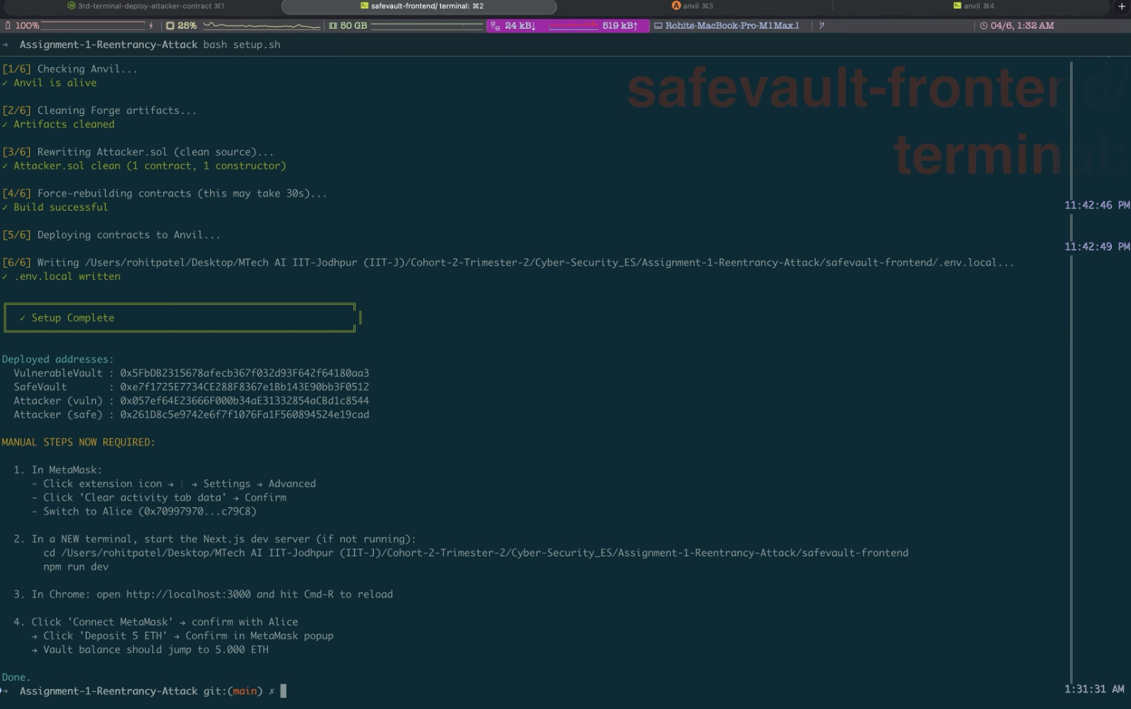
🧪 PROOF · LIVE DEMO — STEP 1 · SETUP & DEPLOY
🛠️ Terminal Image to run the Setup Deployment Process in a single script
bash setup.sh → checks Anvil, cleans artifacts, rewrites Attacker.sol, rebuilds, deploys, writes .env.local — Setup Complete ✅
🔓 Reentrancy Attack · Group 6 · CSL6010 Cyber Security · IIT Jodhpur

Slide 22
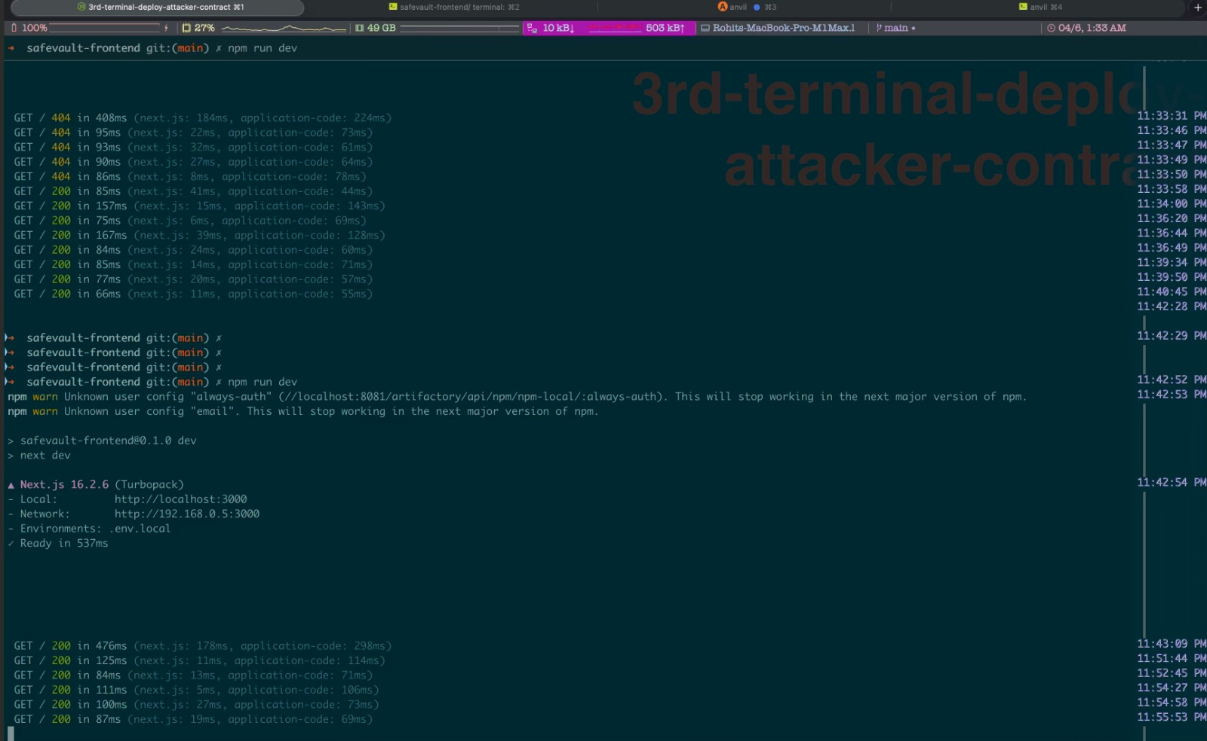
🧪 PROOF · LIVE DEMO — STEP 2 · FRONTEND LIVE
🌐 This Image Runs the application in port number 3000 locally for the SafeVault Bank
npm run dev → Next.js 16.2.6 (Turbopack) ready on http://localhost:3000 · serving the SafeVault Bank dashboard
🔓 Reentrancy Attack · Group 6 · CSL6010 Cyber Security · IIT Jodhpur

Slide 23
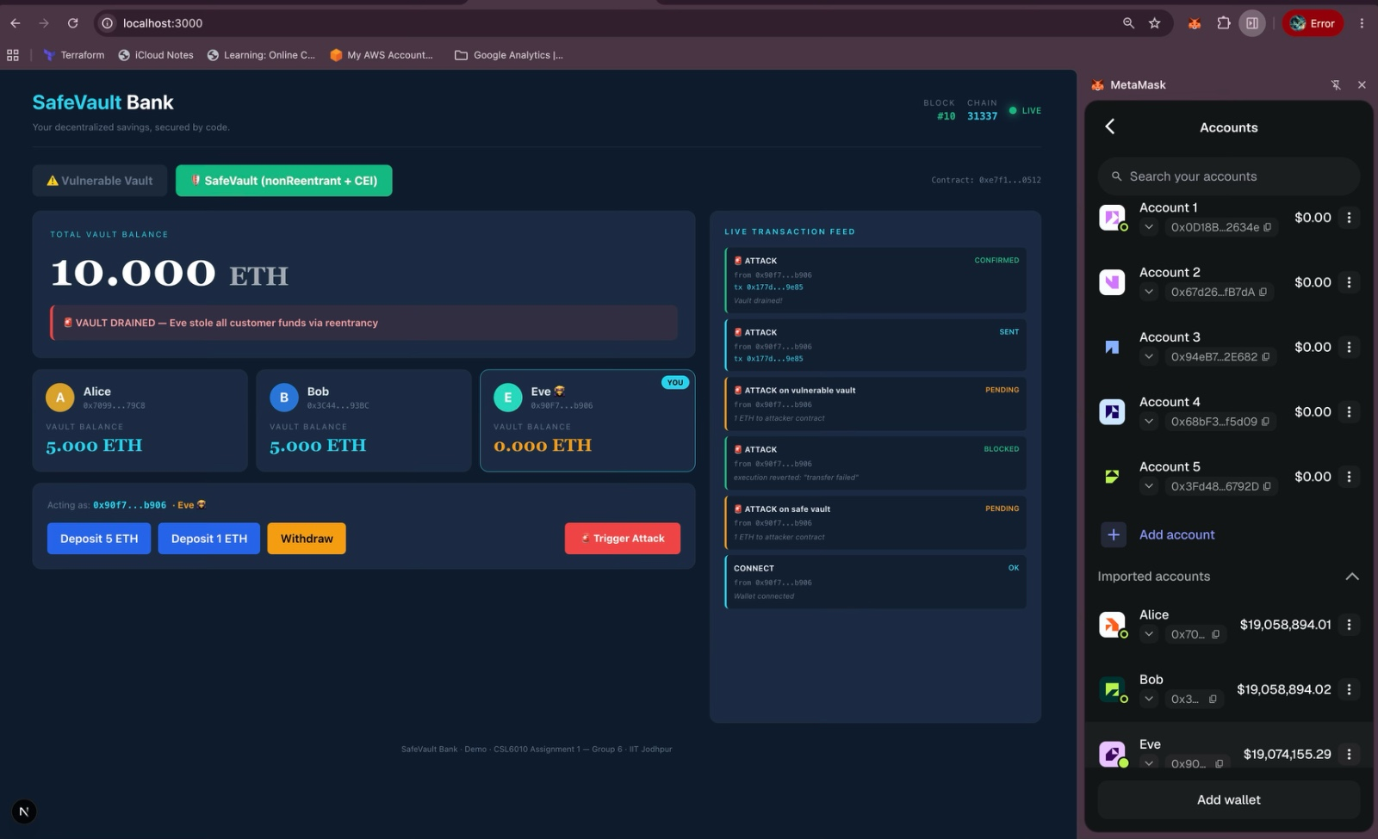
🧪 PROOF · LIVE DEMO — STEP 3 · WALLETS
🦊 MetaMask Image
Anvil based test wallets imported into MetaMask — Alice & Bob (depositors) and Eve (the attacker)
🔓 Reentrancy Attack · Group 6 · CSL6010 Cyber Security · IIT Jodhpur

Slide 24
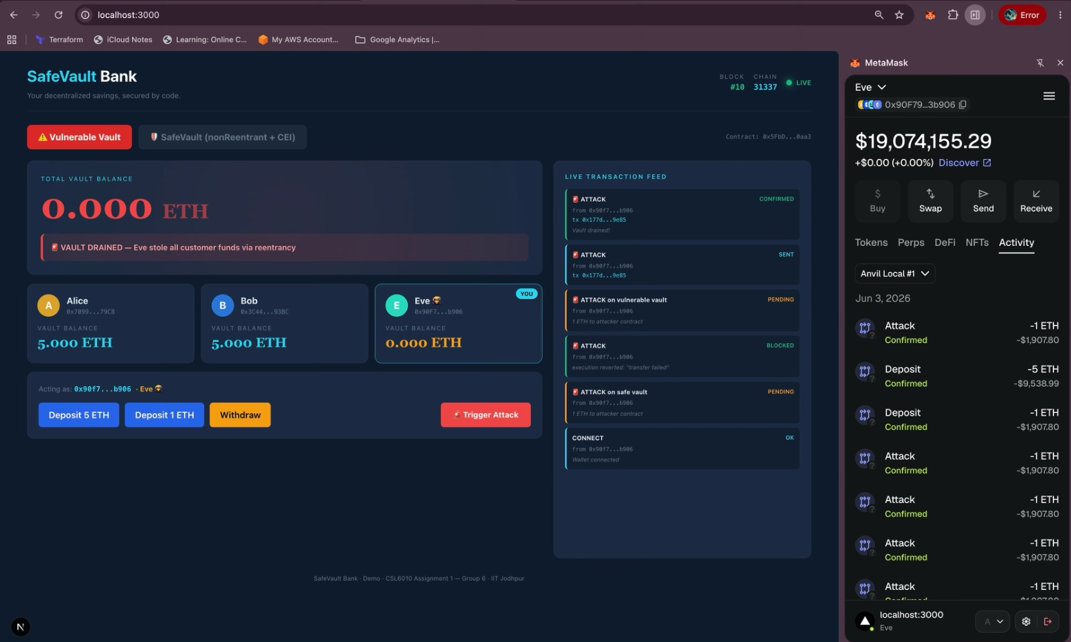
🧪 PROOF · LIVE DEMO — STEP 4 · ATTACK SUCCEEDS
🚨 Above Image is from the VULNERABLE VAULT
Vault DRAINED → 0.000 ETH. Eve walks out with the vault balance (ETH) after a single Trigger Attack on the C → I → E vault.
🔓 Reentrancy Attack · Group 6 · CSL6010 Cyber Security · IIT Jodhpur

Slide 25
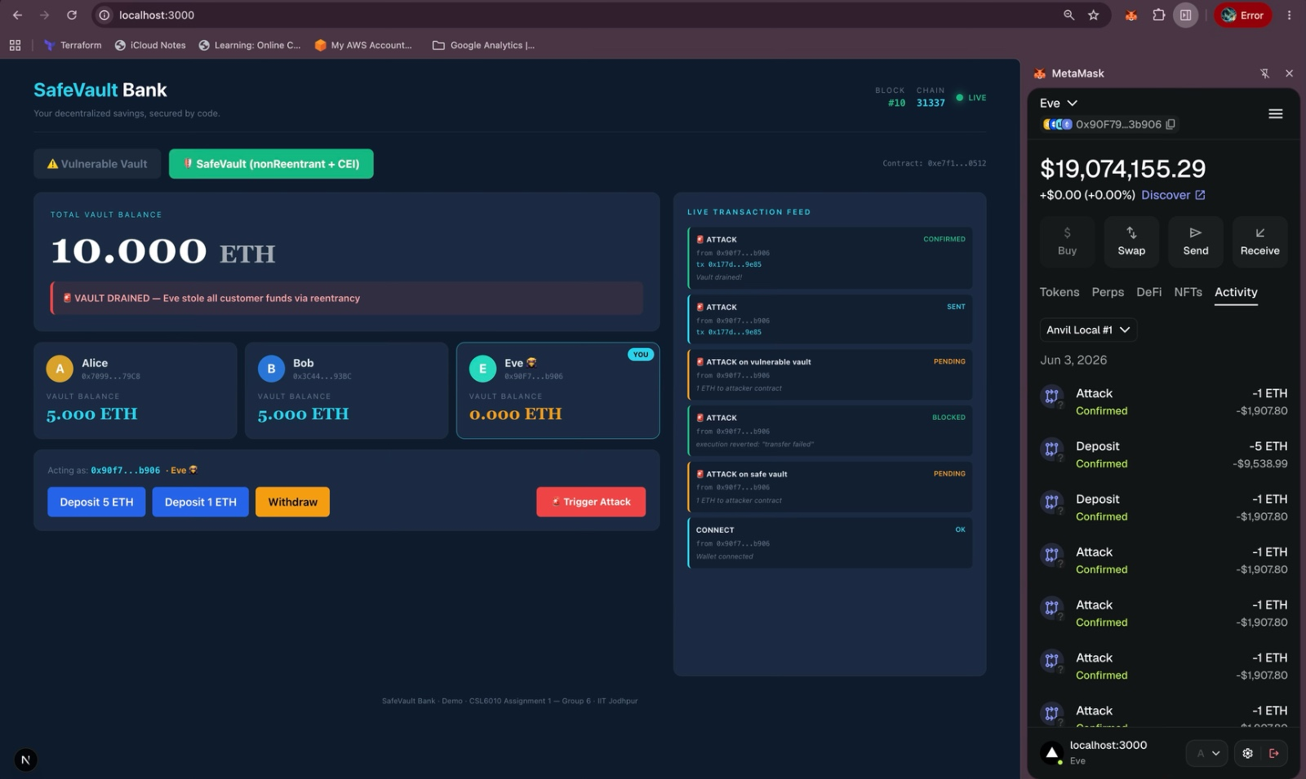
🧪 PROOF · LIVE DEMO — STEP 5 · ATTACK BLOCKED
🛡️ This IMAGE is from the SafeVault (nonReentrant + CEI) Operations
Same exploit, different outcome → vault stays at 10.000 ETH. nonReentrant + Checks-Effects-Interactions prevents the re-entry.
🔓 Reentrancy Attack · Group 6 · CSL6010 Cyber Security · IIT Jodhpur

Slide 26
👥 REQUIRED · TEAM MEMBER CONTRIBUTIONS
👥 Who did ??: Success was driven by the complete dedication of every team member
MEMBER
ROLL NO
CONTRIBUTION
Rohit Patel
G25AIT2089
Attack Design · Foundry demo
Sharvan Vittala
G25AIT2099
Vulnerable Vault contract . Demo Video Recording (Part - I)
Sudeb Ghosh
G25AIT2113
Attacker + fallback exploit . Slides
Kosuru Yuvaraj
G25AIT2054
Fixed contract (CEI + Reentrancy Guard) . Solution/Fix
Pujan Chakraborty
G25AIT2076
Safe Vault . Forge tests + call traces . Documentation(s)
Amit Singh
G25AIT2007
Research · DAO / Curve case studies
Vishnu Priya
G25AIT2128
Frontend + Demo Video Recording (Part-II)
🔓 Reentrancy Attack · Group 6 · CSL6010 Cyber Security · IIT Jodhpur

Slide 27
🎯 ONE-LINE TAKEAWAY
Update your state before you talk to the outside world.
Reentrancy is a logic bug, not a math bug. CEI (state first) + ReentrancyGuard (a lock) closes the door. 🔒
🎯 WHAT
🪤 TRICK
💥 WHERE
🛡️ FIX
pay-before-record bug
re-enter the same call
DAO · Curve · ongoing
CEI + nonReentrant
👥 GROUP 6 Rohit · Sharvan · Sudeb · Yuvaraj · Pujan · Amit · Vishnu Priya
💻 CODE https://github.com/rpaut03l/ts_02_safevault-reentrancy-demo 📚 REF SWC-107 · OpenZeppelin
🙏 Thank you — Questions?

